Slide 1
List Methods
Mack 2023
Notes:
Last updated: 09-12-20
Resources are updated regularly — the latest version is available at: ncce.io/tcc.
This resource is licensed under the Open Government Licence, version 3. For more information on this licence, see ncce.io/ogl.

Slide 2
Make a prediction (think, write, pair, share)
Starter activity
1 2 3 4 5 6 | words = ["python", "java", "C+", "ruby"] for item in words: if item == "python": print(f"{item} is the best") else: print(f"{item} is a programming language")
Question .
What will be the output when this program is executed?
 | python is the best java is a programming language C+ is a programming language ruby is a programming language >>>

Slide 3
Traversing a list
Starter activity
1 2 3 4 5 6 | words = ["python", "java", "C+", "ruby"] for item in words: if item == "python": print(f"{item} is the best") else: print(f"{item} is a programming language")
You can use a for loop to traverse a list of elements.
1 2 3 | word = "python" for item in word: print(item)
You can use the same technique as you used with characters in a string.
 | p y t h o n

Slide 4

List methods
Objectives
In this lesson, you will:
Traverse a list of elements
Use list methods
Create a function that returns a list
Import custom-built functions

Slide 5

List method: index(item)
Activity 1
1 2 3 4 5 | numbers = [4, 5, 3, 2, 9, 10] location = numbers.index(9) print(location)
The index method will check each element in a list against the argument placed inside the brackets.
If the location is found, then the index location is returned.
Question .
What will be the output when this program is executed?
 | 4 >>>
Important: It will only return the index of the first match that it finds.

Slide 6
List method: insert(index, item)
Activity 1
1 2 3 4 5 | numbers = [4, 5, 3, 2, 9, 10] numbers.insert(2,10) print(numbers)
The insert method will insert an item at the location specified in the arguments. The items make room for the new item.
Question .
What will be the output when this program is executed?
 | [4, 5, 10, 3, 2, 9, 10] >>>

Slide 7
List method: pop(index)
Activity 1
1 2 3 4 5 | numbers = [4, 5, 3, 2, 9, 10] numbers.pop(0) print(numbers)
The pop method is another way to remove an item from a list. This will remove it based on the index location rather than the contents of the item as seen with remove().
Question .
What will be the output when this program is executed?
 | [5, 3, 2, 9, 10] >>>

Slide 8
List method: count(item)
Activity 1
1 2 3 4 5 | numbers = [4, 10, 5, 3, 2, 9, 10] total = numbers.count(10) print(total)
The count method counts how many times it finds the value given in the arguments. It returns the total number of occurrences.
Question .
What will be the output when this program is executed?
 | 2 >>>

Slide 9
List method: reverse()
Activity 1
1 2 3 4 5 | numbers = [4, 10, 5, 3, 2, 9, 10] numbers.reverse() print(numbers)
The reverse method reverses the list of items.
Question .
What will be the output when this program is executed?
 | [10, 9, 2, 3, 5, 10, 4] >>>

Slide 10
List method: sort()
Activity 1
1 2 3 4 5 | numbers = [4, 10, 5, 3, 2, 9, 10] numbers.sort() print(numbers)
The sort method sorts the list into ascending order.
Question .
What will be the output when this program is executed?
 | [2, 3, 4, 5, 9, 10, 10] >>>

Slide 11
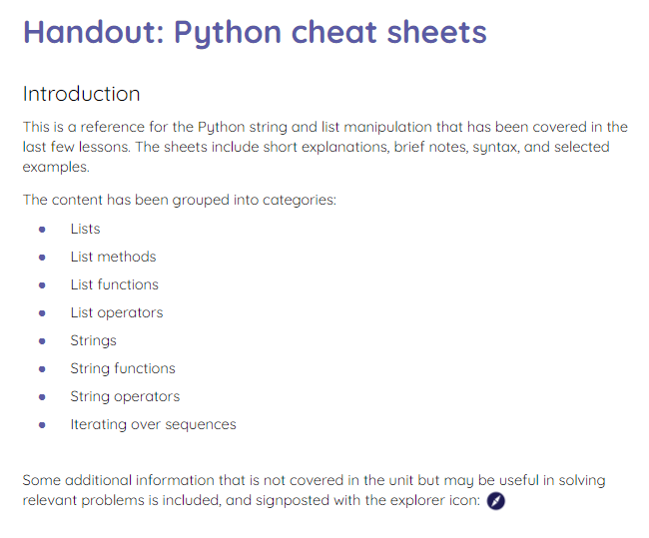
Python cheat sheets
Activity 1
A collection of cheat sheets that cover string- and list-manipulation techniques can be used if you need a reminder.

Slide 12
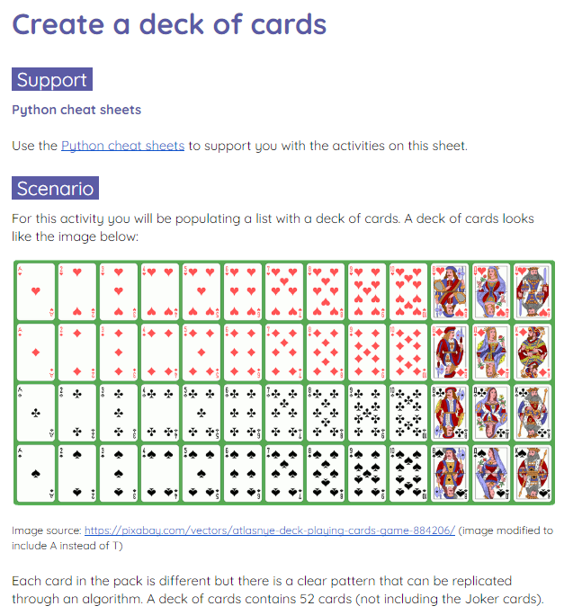
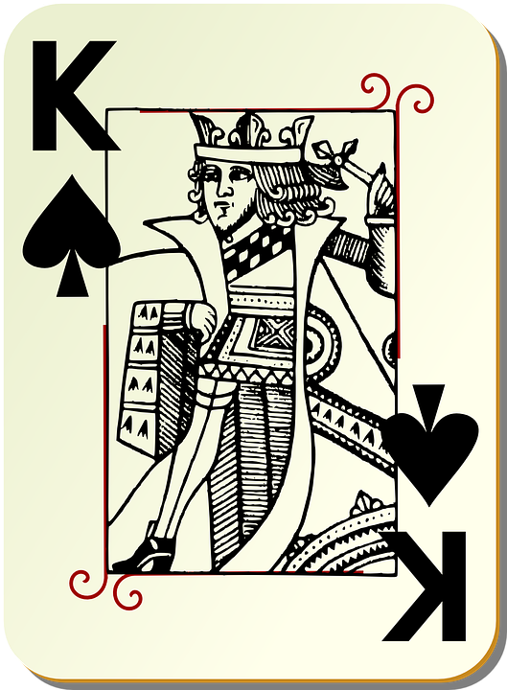
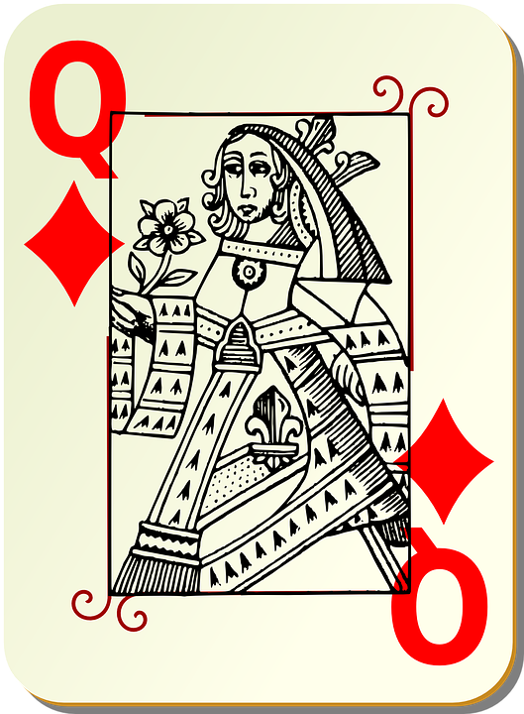
Manipulating lists
Activity 2
Complete the worksheet to create a deck of cards that could be used with a card game like Snap!
Notes:
Image source: https://pixabay.com/vectors/playing-card-queen-card-deck-deck-161491/
Image source: https://pixabay.com/vectors/playing-card-king-card-deck-deck-161489/

Slide 13
Return a list from a function
Activity 3
A function returns a value.
Sometimes you need a function to return more than one value.
A list is a method that you can use to return more than one value from a function.

Slide 14
Return a list from a function
Activity 3
Here is a function that populates a list with the letters of the alphabet.
def alphabet_list():
alphabet = []
for x in range(65,91):
alphabet.append(chr(x))
return alphabet
print(alphabet_list())

Slide 15
Return a list from a function
Activity 3
When the function is called, the list is populated inside the function and then returned.
def alphabet_list():
alphabet = []
for x in range(65,91):
alphabet.append(chr(x))
return alphabet
print(alphabet_list())
['A', 'B', 'C', 'D', 'E', 'F', 'G', 'H', 'I', 'J', 'K', 'L', 'M', 'N', 'O', 'P', 'Q', 'R', 'S', 'T', 'U', 'V', 'W', 'X', 'Y', 'Z']
>>>

Slide 16

Return a list from a function
Activity 3
The deck of cards program can be turned into a function so that you can call it whenever you need a new deck of cards.
Live coding

Slide 17
Creating a custom-built function
Activity 4
All of the functions that you create can be used in other programs where required.
You could just copy and paste the code each time, but this would be inefficient.
Instead, you can save your functions in a separate Python file and import them into your programs.

Slide 18
Creating a custom-built function
Activity 4
You have used these lines of code many times to import functions into your programs.
You can do this same thing for your own custom-built functions.
from random import randint
from time import sleep
from guizero import App

Slide 19
Creating a custom-built function
Activity 4
You can turn your deck of cards function into a custom-built function to use whenever you need a deck of cards in any of your programs.
Live coding

Slide 20
Match the methods to their description
Wrap Up
index(item)
Returns a total of the occurences of an item
insert(index, item)
Deletes the item at the identified location
pop(index)
Manipulates a list so that it appears in ascending order
count(item)
Adds a specified item at an identified location
sort()
Returns the index location of the specified item

Slide 21
Next lesson
Summary
In this lesson, you…
Learnt about some new list methods that can be used in your programs
Used a for loop to append a list
Created a custom-built function to use in your programs
Next lesson, you will…
Learn about a Sense HAT, and how you can manipulate arrays to work with a Sense HAT

